Slide 1
Sorting Algorithms
Stefanoiu Rares Andrei

Slide 2
Test 8

Slide 3
Counting Sort
Execution time:
N=10 Max=100000000 : 0.751667seconds
N=100 Max=10000000: 0.632263seconds
N=1000 Max=1000000: 0.010414seconds
N=10000 Max=100000: 0.001479seconds
N=100000 Max=10000: 0.002822seconds
N=1000000 Max=1000: 0.008359seconds
N=10000000 Max=100: 0.094914seconds
N=100000000 Max=100000000: 11.7502seconds

Slide 4
Counting sort
Time Complexity: O(n+k) k- maximum number
It is the most efficient algorithm on big tests(test 8) and on the ones where k<n(test 7), but it is extremely slow on tests where k>=n^2(test 1).

Slide 5
Merge Sort
N=10 Max=100000000: 3microseconds
N=100 Max=10000000: 18microseconds
N=1000 Max=1000000: 0.000458seconds
N=10000 Max=100000: 0.005153seconds
N=100000 Max=10000: 0.043986seconds
N=1000000 Max=1000: 0.383996seconds
N=10000000 Max=100: 2.74538seconds
N=100000000 Max=100000000: 43.197seconds

Slide 6
Merge sort
Time Complexity: O(nlogn)
It performs similar to shell sort on tests with less numbers, but it is faster on tests with a lot of numbers.(test 8)

Slide 7
Shell Sort
N=10 Max=100000000: 1microseconds
N=100 Max=10000000 : 26microseconds
N=1000 Max=1000000: 0.000409seconds
N=10000 Max=100000: 0.005303seconds
N=100000 Max=10000: 0.05616seconds
N=1000000 Max=1000: 0.477778seconds
N=10000000 Max=100: 2.41322seconds
N=100000000 Max=100000000: 104.864seconds

Slide 8
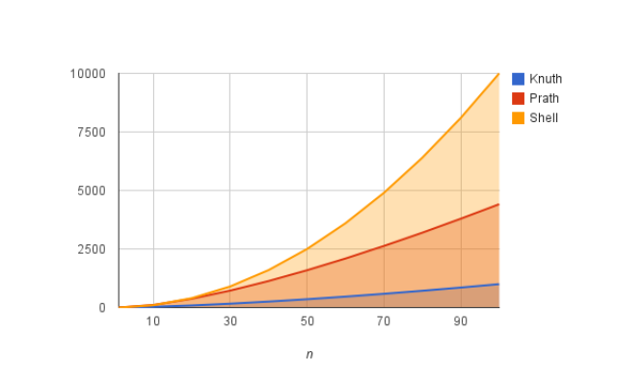
Shell Sort
Time Complexity: O(n^(3/2)) (Knuth sequence)
It is a little bit slower than merge sort.

Slide 9
Radix sort(baza 10)
N=10 Max=100000000: 24microseconds
N=100 Max=10000000: 0.000111seconds
N=1000 Max=1000000: 0.000763seconds
N=10000 Max=100000: 0.006639seconds
N=100000 Max=10000: 0.043626seconds
N=1000000 Max=1000: 0.245233seconds
N=10000000 Max=100: 1.615536seconds
N=100000000 Max=100000000: 45.7138seconds

Slide 10
Radix sort
k-maximum number
b-base
Time Complexity: logb (k) *(n+min(k,b))
The higher the base the better performance on long tests with big numbers.
Test 8

Slide 11
Heapsort
N=10 Max=100000000: 2microseconds
N=100 Max=10000000: 0.000195seconds
N=1000 Max=1000000: 0.00138seconds
N=10000 Max=100000: 0.013686seconds
N=100000 Max=10000: 0.102487seconds
N=1000000 Max=1000: 1.76876seconds
N=10000000 Max=100: 13.288seconds
N=100000000 Max=100000000: 223.688seconds
Time Complexity: O(nlogn)
The slowest algorithm from the tested ones.

Slide 12
Sort
N=10 Max=100000000: 47microseconds
N=100 Max=10000000: 0.000268seconds
N=1000 Max=1000000: 0.001407seconds
N=10000 Max=100000: 0.011071seconds
N=100000 Max=10000: 0.094129seconds
N=1000000 Max=1000:0.561513seconds
N=10000000 Max=100: 3.95106seconds
N=100000000 Max=100000000: 125.316seconds
Time Complexity:O(NlogN)

